Slide 1
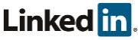
Secure & Manage customers at scale with Microsoft 365 Lighthouse
Leonardo Cruz
Cloud Solution Architect
Security & Compliance
https://www.linkedin.com/in/lcruzp/

Slide 2
Microsoft 365 Lighthouse
Overview
Benefits
Setup and Manage
Demo
Q&A

Slide 3
Microsoft 365 Lighthouse

Slide 4
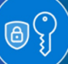
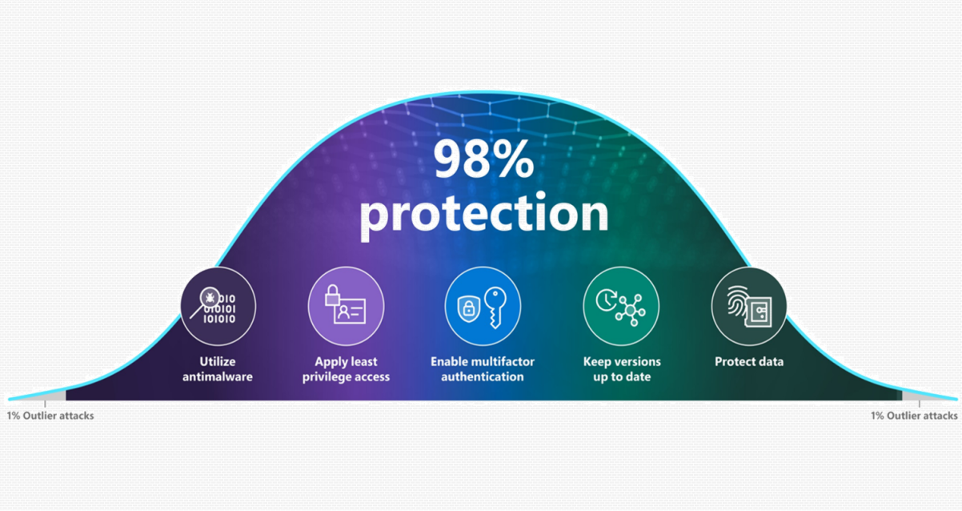
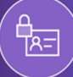



Ensure you cover the basics
Basic security hygiene still protects against 98% of attacks
Enable multifactor authentication
Apply zero trust principles
Use modern anti-malware
Keep up to date
The cyber resilience bell curve
Source: Microsoft Digital Defense Report 2022
Protect data

Slide 5
Microsoft 365 Lighthouse overview
Helps Managed Service Providers to secure devices, data, and users for customers that have up to 2500 licensed users with Microsoft 365 Business Premium, Microsoft 365 E3, Microsoft 365 E5, or Microsoft Defender for Business subscriptions
Customer management at scale
Monitor and manage customers centrally to easily identify gaps in end-customer configuration, target improvements, and drive adoption.
Proactive risk management
Realize efficiencies in customer management to support business scale and growth
Improved security
Secure and protect devices, data, and users across customer environments using recommended best practices.
Standardize configuration
Benefit from deployment plans to drive standardization, upsell across customer base, and reduce risk
Enable least privilege access in Microsoft 365 Lighthouse with Granular Delegated Administrative Privileges (GDAP).

Slide 6

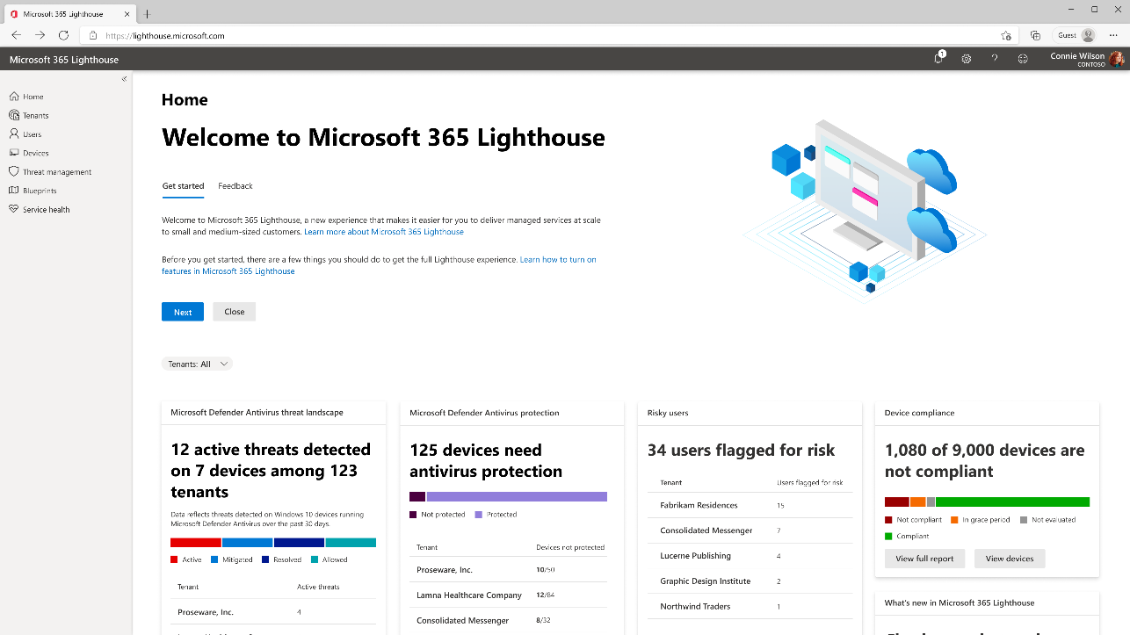
Customer management at scale
Unified portal
A single place for securing all your Microsoft 365 Business Premium, and Microsoft 365 E3 tenants.
Ease of use
Perform common tasks without the login/logout of individual customer tenants.
Reduce friction
Action-oriented dashboard and quick links resources and configuration pages.

Slide 7

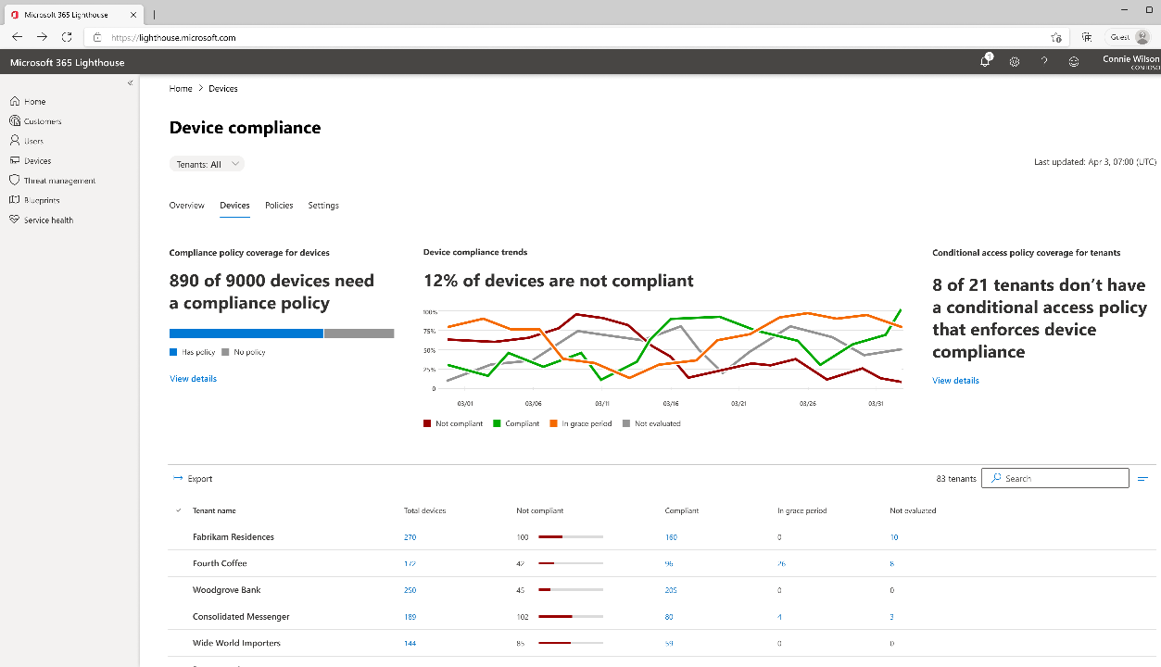
Proactive risk management
Review
Simplified view of device compliance, threat landscape, antivirus status, and risky user sign-ins across your customer base.
Prioritize
Prioritize action to resolve customers that need attention.
Act
Help ensure each customer has adopted security baselines to mitigate risk and provide governance.

Slide 8
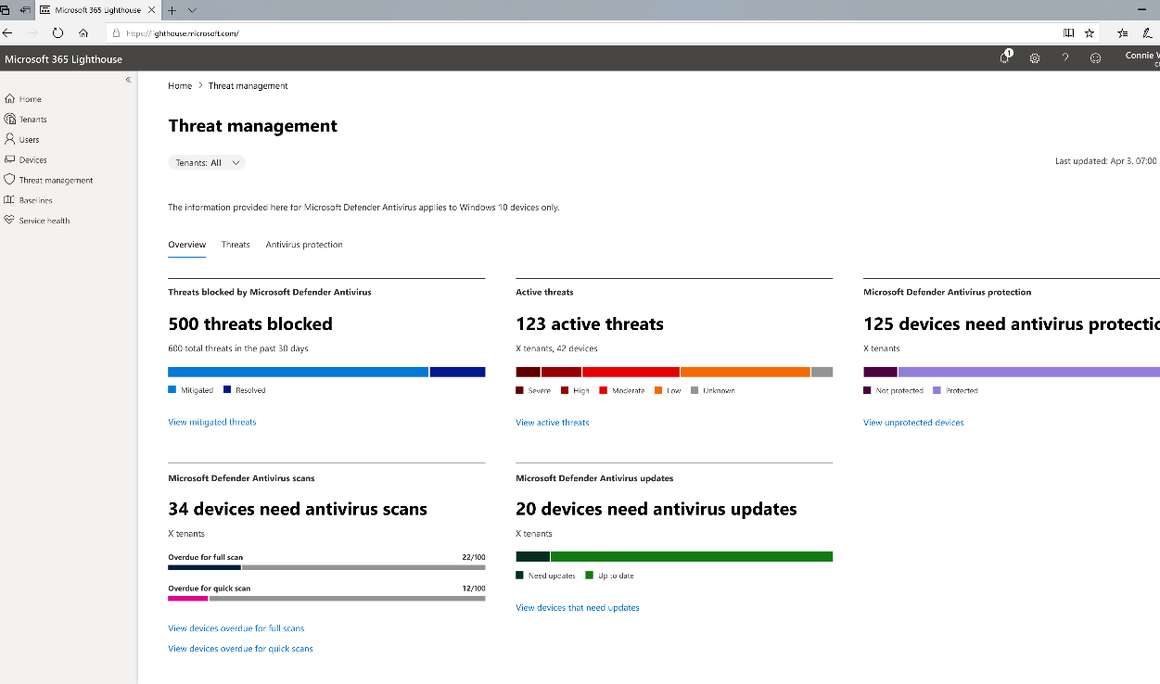
Improved security
Device compliance
Quickly identify which customers have device compliance policies configured, and which require attention.
Threat management and Antivirus
View status of Microsoft Defender Antivirus and active threats across all Windows 10 devices.
Securing users
Gain insights into risky sign-ins and conditional access policy settings.

Slide 9
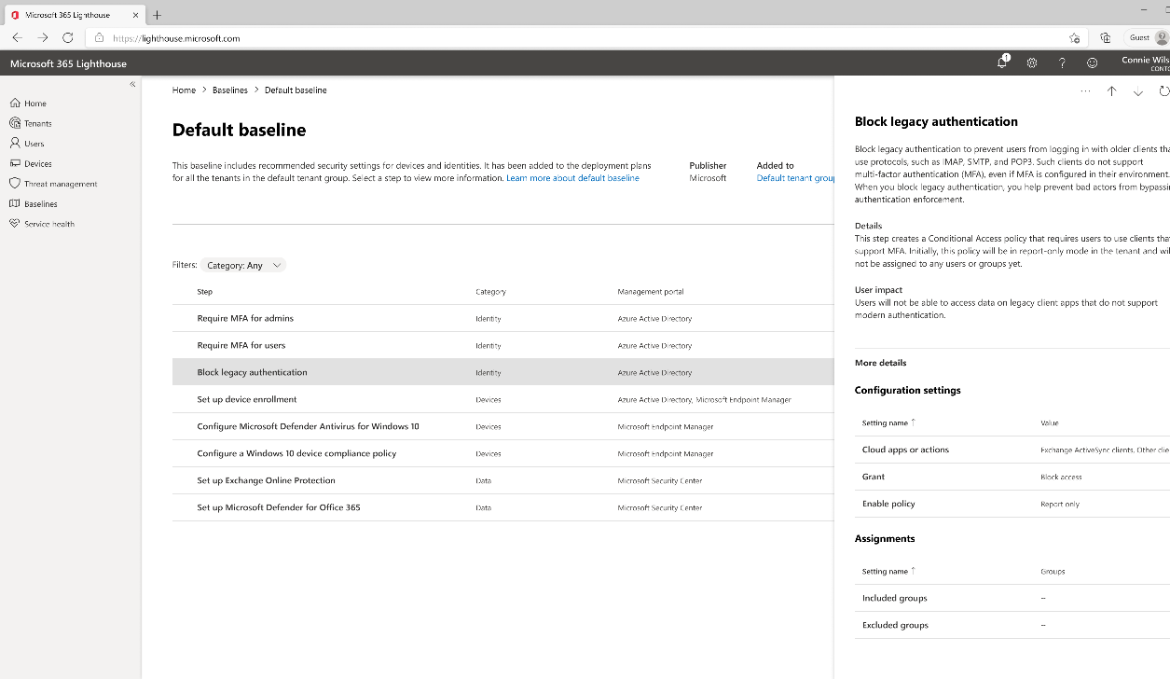
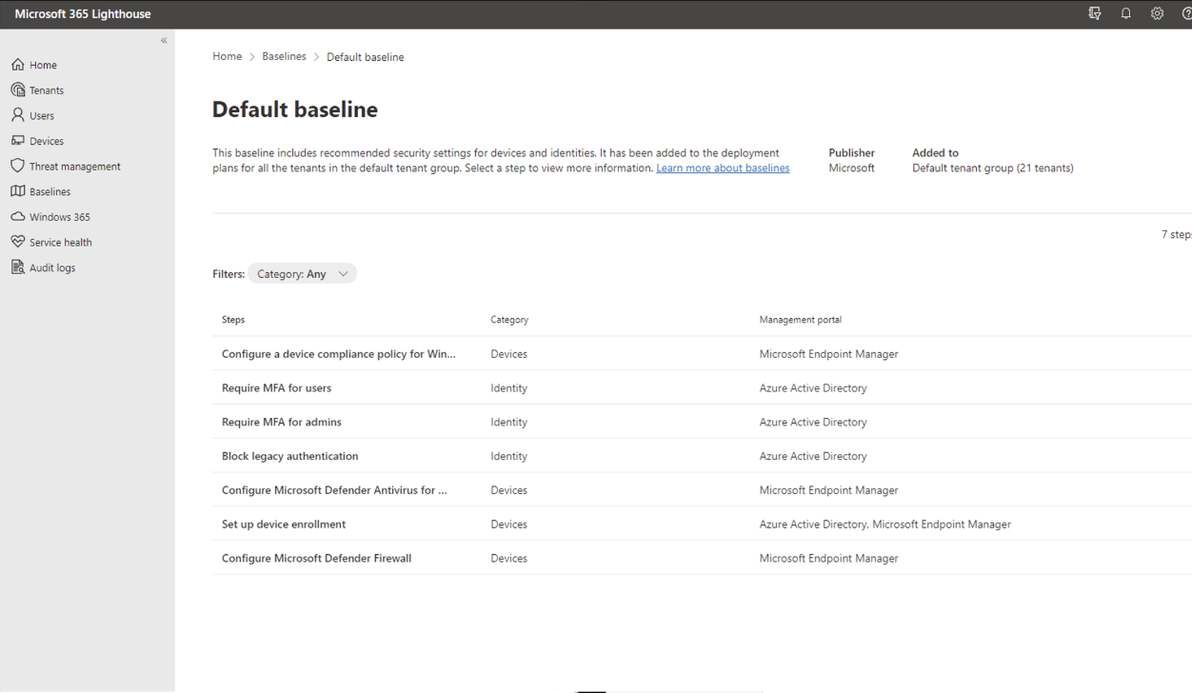
Standardize configuration
Recommended settings
Baselines are Microsoft’s recommended settings and policies optimized for small and medium sized businesses.
Consistent deployment
Move beyond monitoring by deploying consistent security standards across new and existing customers using Deployment plans.

Slide 10
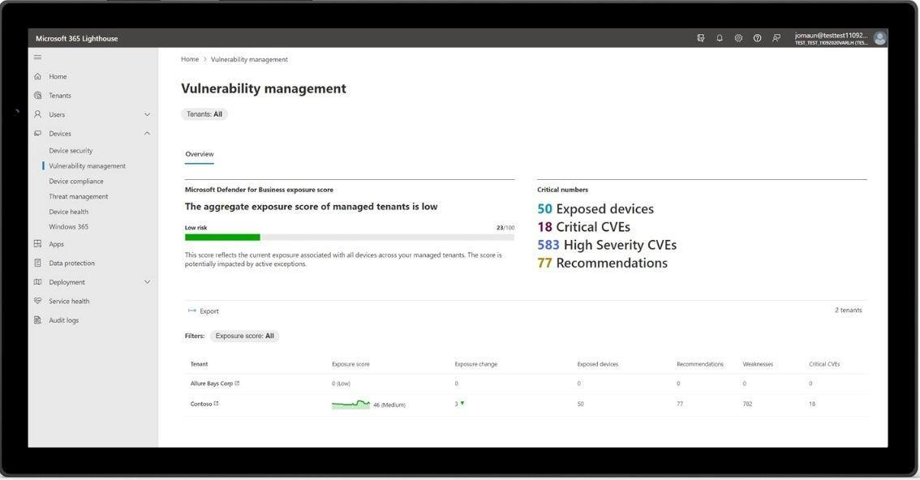
Exposure score in Microsoft 365 Lighthouse
New
Exposure score is now available within Microsoft 365 Lighthouse, to help partners identify where customer’s devices are most at risk from vulnerabilities with active threats.
It helps to reduce exposure with recommendations to patch devices with the latest updates and proactively improve customer’s device security in Defender for Business and Microsoft 365 Business Premium tenants.

Slide 11
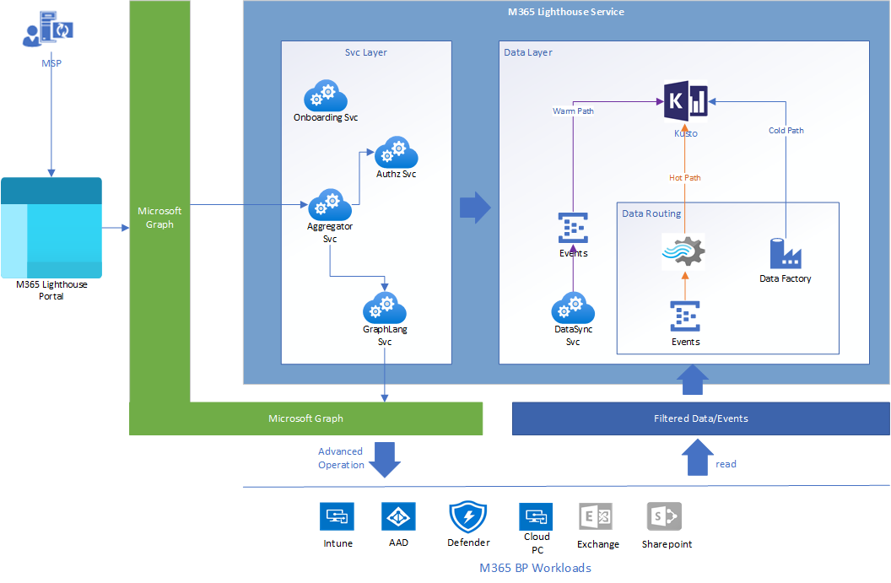
Microsoft 365 Lighthouse – Approaches and Technologies
A data ingestion platform​
Hosted on Graph​
Multi-Tenant– the APIs are in the Service Provider’s Context but exposes data from their Customers Tenants so “Multi-Tenant”​
Integrated with Partner Center/AAD for Partner to customer relationships​
Has both a push and a pull model for ingesting data​

Slide 12
Microsoft 365 Lighthouse Setup & Management

Slide 13
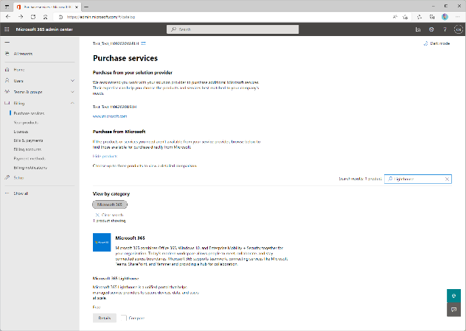
Onboarding to M365 Lighthouse
Partner Tenant
MSPs must be enrolled in the Cloud Solution Provider (CSP) program as an Indirect Reseller or Direct Bill partner to use Lighthouse.
Add the free M365 Lighthouse offer from Admin Center:
Customer Tenants
Have a delegated access setup (DAP or GDAP)
Including no reseller relationship
Have at least one of the following subscriptions:
Microsoft 365 Business Premium
Microsoft 365 E3/E5
Windows 365 Business
Microsoft Defender for Business
No more then 2,500 licensed users
Must reside in the same geographic region as the partner organization that manages them
Activate Microsoft 365 Lighthouse : aka.ms/m365lighthouseonboard

Slide 14
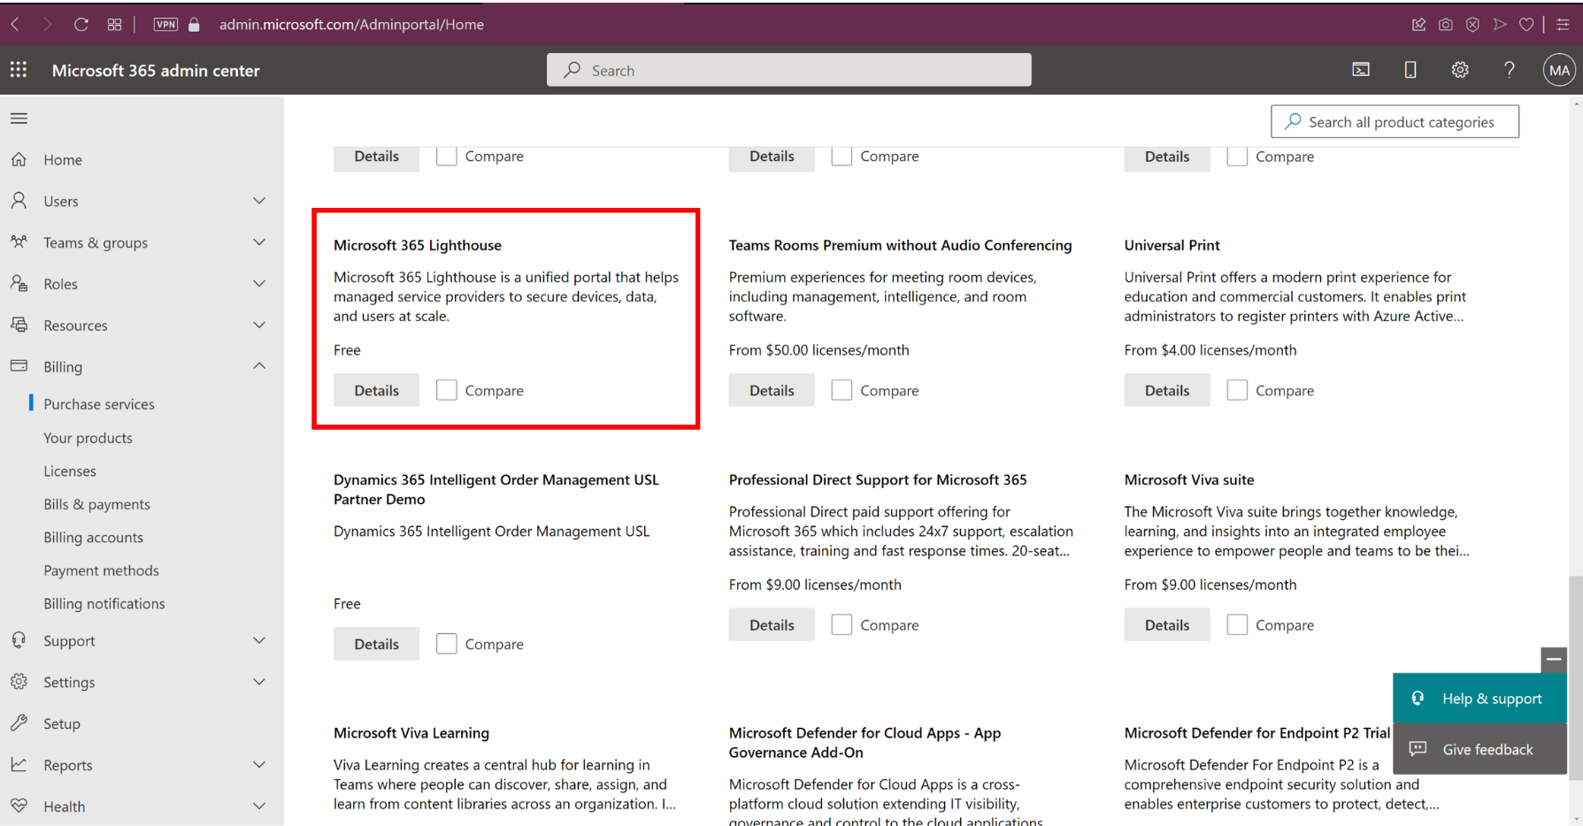
Add Microsoft 365 Lighthouse

Slide 15
Microsoft 365 Lighthouse - Demo Baselines and Customer Tenants

Slide 16
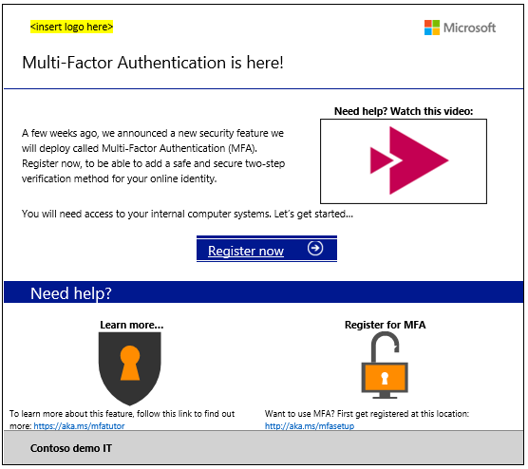
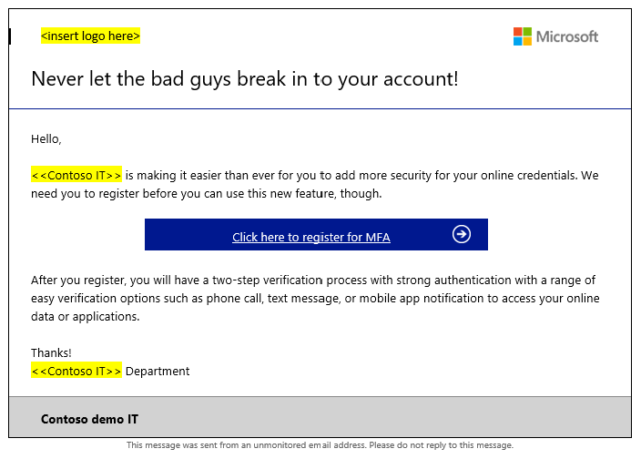
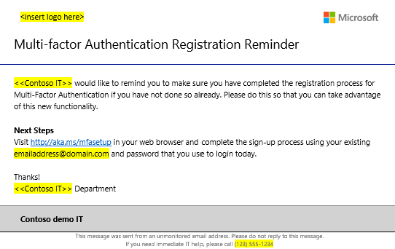
MFA Rollout Materials

Slide 17

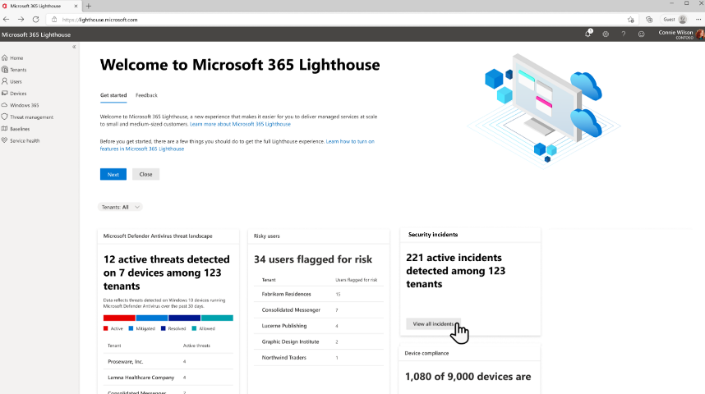
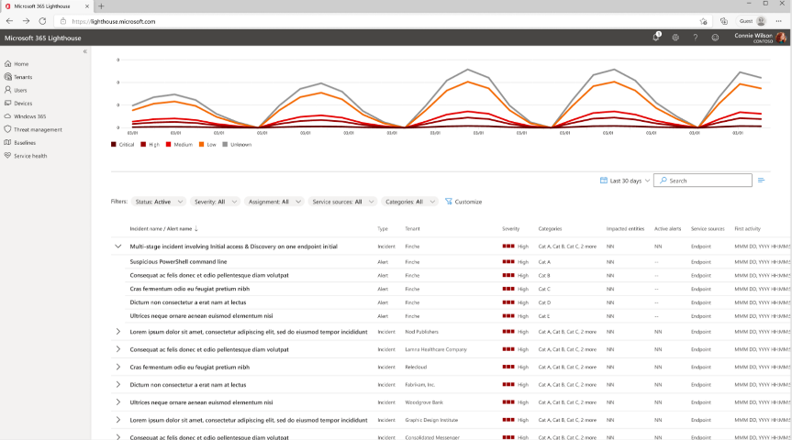
Microsoft 365 Lighthouse with Defender for Business and Microsoft Business Premium
View security incidents, alerts and devices from Defender for Business in the dashboard and get the detail from the Incidents queue*. Additional security management capabilities are planned on the roadmap.
Image 1: Security incident summary on the Home dashboard
Image 2: Incident queue highlighting security incidents and alert details

Slide 18
Demo
Managing customers with Microsoft 365 Lighthouse

Slide 19
DAP vs. GDAP (Granular Delegated Admin Privileges)

Slide 20
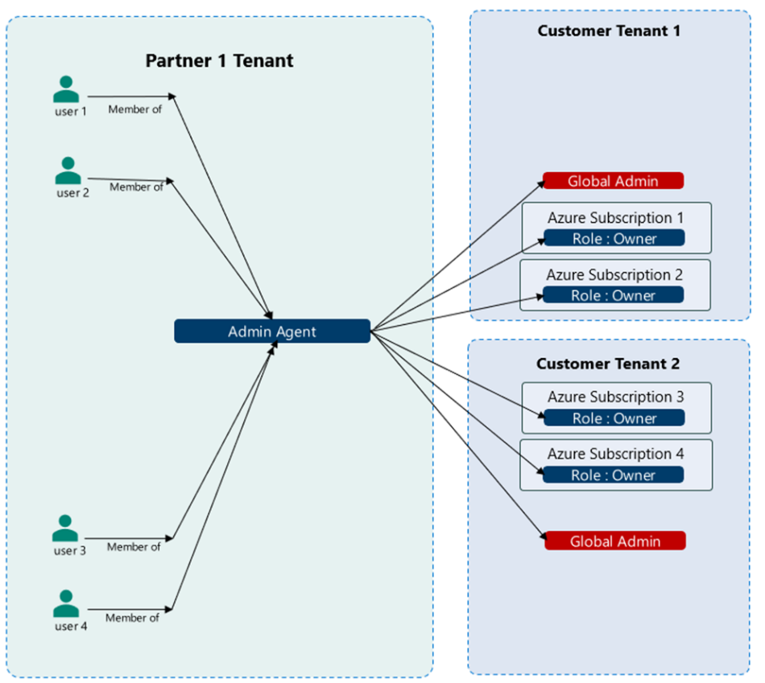
DAP Delegated Administrative Privileges
Limitations:
Users belonging to Admin Agent group get owner RBAC Azure subscription access to all customers
Users belonging to Admin Agent group get Global Admin tenant role
Users belonging to Help Desk Agent group get Help Desk Admin tenant role
Cannot partition access per employee
Cannot partition access per customer
Cannot partition access per workload
Access is perpetual (does not auto expire)
Action Required:
Transition from DAP to GDAP

Slide 21
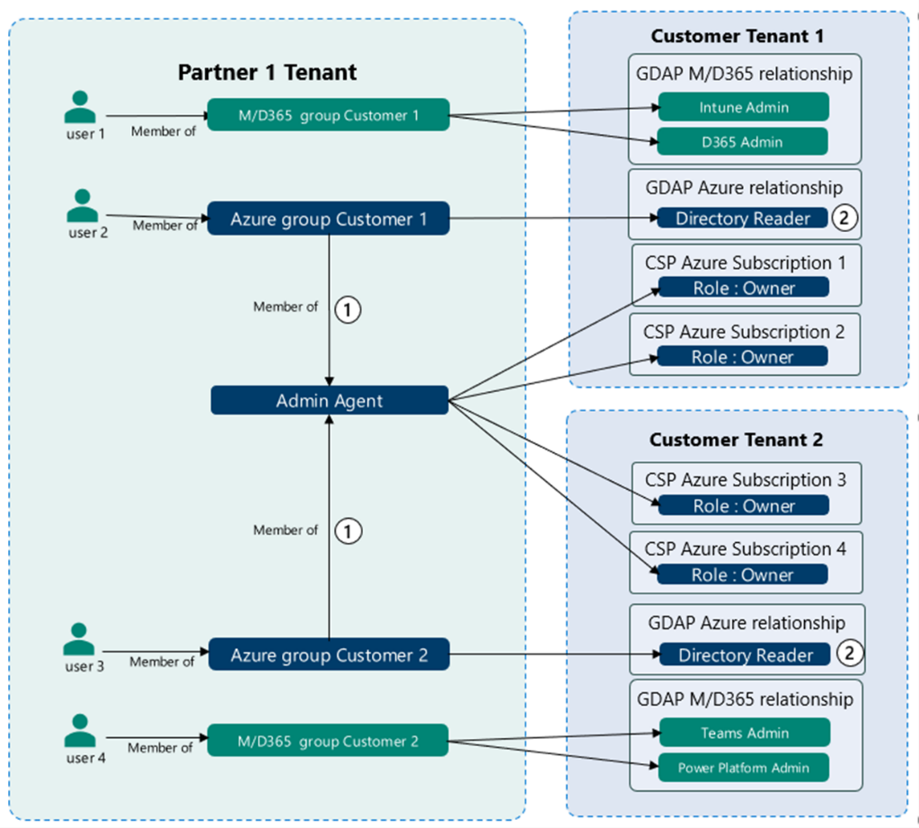
GDAP Granular Delegated Administrative Privileges
Users managing Azure need to be part of a separate security group which is nested under (member of) Admin agent group which will grant owner RBAC access on all Azure subscriptions for that customer
Users managing Azure will not get Global Admin role on customer’s tenant but will get lower permission - to read customer directory by default
User’s access can be partitioned per customer. Users will not have access to all customer tenants across all azure subscriptions through Admin agents by default
Partners can transition from DAP to GDAP and ultimately remove DAP (Global Admin) on customer’s tenant without any impact to Partner earned credit (PEC) since PEC is calculated based on owner RBAC access (not global admin role)

Slide 22
GDAP Granular Delegated Administrative Privileges
Notes:
Enables technician (CSP or Microsoft user) to access customer tenant w/o user footprint
Customer can’t assign access to technician – only partner admin can assign access
Preserve traceability without exposing personal data
Not all M365 services support GDAP token for all administrative tasks. This prevents partners from decommissioning local accounts in customer tenants.
GDAP token is backward compatible with DAP token
Role assignment support:
Only built-in AAD roles, e.g. Global reader, Security Admin
Doesn’t support workload specific roles, e.g, “VM Contributor”, “SharePoint Site admin”
Doesn’t support custom AAD roles, e.g., “Contoso Device Admin”
Doesn’t support custom workload roles, e.g., “Contoso Networking admin”
Scope
Tenant-scoped only
Doesn’t support Admin-unit scoped role assignments
Workload-specific scopes, Azure subscriptions or resource groups, SP sites…

Slide 23

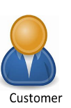

Partner and customer journey
Onetime Org to Org setup
Cannot change definition of GDAP request (roles and duration) once customer approves (Contract)
Partner Admin Agent
1
2
Create and Save GDAP request defined by AAD Role(s) & duration
Send link to customer for approval in email
Approve GDAP request
Multiple times (Ongoing as needed)
AAD Portal
Can be changed by partner
multiple times as needed
customer reapproval not required
Partner Admin Agent
3
4
5
6
Create users & security groups
Assign user(s) to security groups
View approved GDAP relationship
Assign approved AAD Roles in GDAP relationship to Security Groups

Slide 24
Set up GDAP for your customers (1)
Tiers of Permissions
Account Managers
License Administrator
Message Center Reader
…
Permissions
Service desk
Security Readers
Helpdesk Administrator
…
Azure AD Built-in Roles
Specialists
Intune Administrator
SharePoint administrator
…

Slide 25
Set up GDAP for your customers (2)
Tiers of Permissions
GDAP Templates
Silver Service Tier
Service Desk
Account Managers
Service Desk
Bronze Service Tier
Account Managers
Service Desk
Specialists
Escalation Engineers
Gold Service Tier
Account Managers
Specialists
Escalation Engineers
JIT Only

Slide 26
Set up GDAP for your customers (3)
Security Groups/users
GDAP Templates
Customer Tenants
Sg-AccountManagers
User 1
User 2
Silver Service Tier
Service Desk
Customer
Customer
Customer
Customer
Customer
Customer
Sg-ServiceDesk
User 3
User 4
Bronze Service Tier
Account Managers
Service Desk
Customer
Customer
Customer
Sg-Specialists
User 1
User 5
User 6
Gold Service Tier
Account Managers
Service Desk
Specialists
Customer
Customer

Slide 27
DEMO
GDAP Setup with M365 Lighthouse

Slide 28
GDAP: Recommended Practices
Properly design GDAP permission from the beginning
Understand supported workloads and current limitations on each
Identify supported Azure AD Roles and RBAC roles
Use Microsoft 365 Lighthouse to define the tiers of permissions and reusable templates
GDAP relationship is not permanent
By default, expires after two years (maximum duration)
Partner need to request a new GDAP relationship manually
Conditional Access policies from customer
May exclude Service Provider from current CA policies or
Customer could create a specific Conditional Access policy for the Service Provider.
https://learn.microsoft.com/en-us/partner-center/gdap-supported-workloads

Slide 29
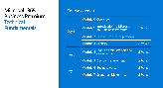
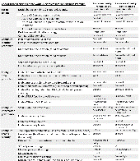
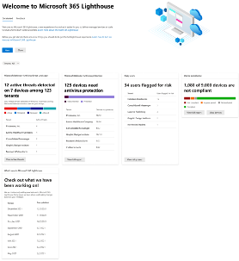
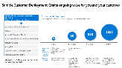
Tools to help you get started on building managed services
Microsoft 365 Business Premium Partner Playbook
Practice Guidance from MSP peers
Technical Training
Compete conversation guide
Sales guidance –upsell guides
Customer ready video/1 pagers/decks
Microsoft 365 Lighthouse
Customer management at scale
Proactive risk management
Standardize configuration
Improved security
aka.ms/M365BPPlaybook
aka.ms/M365Lighthouse

Slide 30
Thank you.

Slide 31
Why do I need to invest in additional security if I already have and Anti-virus solution?

Slide 32






AV is not enough!
300%
increase in identity attacks over the past year³
Phishing and stolen credentials (hacking) are among the top threat action varieties in breaches for SMBs²
+300%
Ransomware attacks in the past year, with more than 50% targeted at small businesses ⁶
¹ Source: https://www.microsoft.com/security/blog/2019/08/20/one-simple-action-you-can-take-to-prevent-99-9-percent-of-account-attacks/ based on MSFT internal study
2.2020 Verizon Data Breach Investigations Report
3. MSFT Internal research

Slide 33


Microsoft Defender for Endpoint next generation protection engines
Metadata-based ML
Behavior-based ML
AMSI-paired ML
File classification ML
Detonation-based ML
Reputation ML
Smart rules
Stops new threats quickly by analyzing metadata
Identifies new threats with process trees and suspicious behavior sequences
Detects fileless and in-memory attacks using paired client and cloud ML models
Detects new malware by running multi-class, deep neural network classifiers
Catches new malware by detonating unknown files
Catches threats with bad reputation, whether direct or by association
Blocks threats using expert-written rules
Cloud
Client
ML
Behavior monitoring
Memory scanning
AMSI integration
Heuristics
Emulation
Network monitoring
Spots new and unknown threats using client-based ML models
Identifies malicious behavior, including suspicious runtime sequence
Detects malicious code running in memory
Detects fileless and in-memory attacks
Catches malware variants or new strains with similar characteristics
Evaluates files based on how they would behave when run
Catches malicious network activities

Slide 34
Microsoft Defender for Business
Elevate your security
Endpoint protection specially designed for businesses with up to 300 employees.
Enterprise-grade protection
Protect your devices against ransomware and other cyberthreats with industry-leading Defender technologies like endpoint detection and response and threat and vulnerability management.
Easy to use
Get up and running quickly with easy, wizard-based onboarding. Out-of-the box policies and automated investigation and remediation help automatically protect you against the latest threats, so you can focus on running your business.
Cost-effective
Security that just works without compromising budget.
Available in two flexible plans as part of Microsoft 365 Business Premium, or as a standalone solution for $3 per user per month.
Microsoft Defender for Business is available in Microsoft 365 Business Premium and as a standalone SKU. https://aka.ms/SMBSecurityMayBlog

